Slide 1
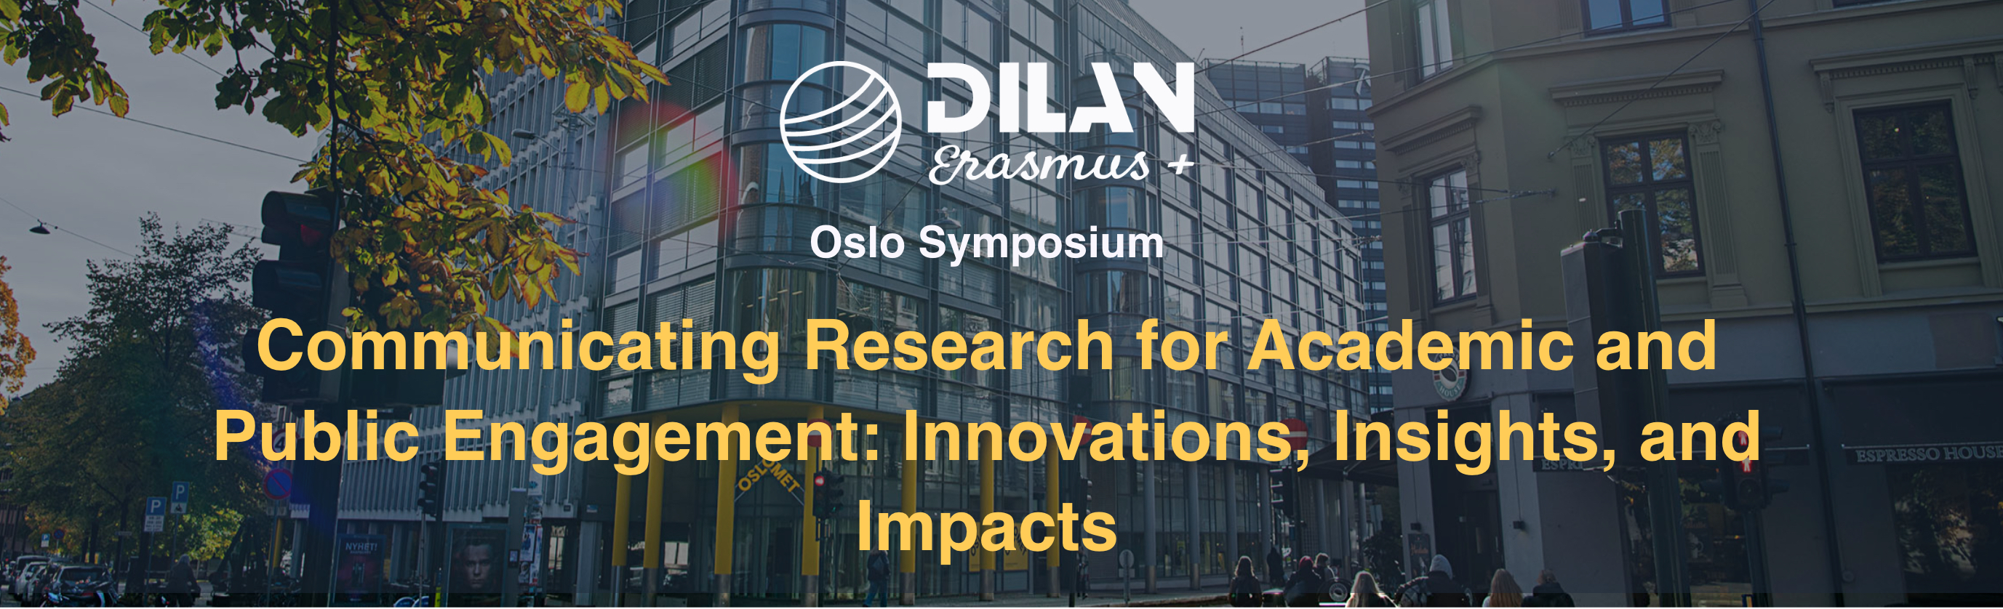

From Research to Reach
Communicating Science Effectively on Social Media- Workshop
Julio Gimenez- University of Westminster

Slide 2

Map of the Workshop
01
02
03
REFLECTING
PRINCIPLES
STRATEGIES
04
05
CRITICAL REFLECTION
FINAL TASK
Icebreaker: Memorable Science Posts
Principles of Effective Science Communication
Key Strategies for Different Platforms
Discussing and Sharing Ideas
Drafting Your Own Post

Slide 3
01
REFLECTING
Memorable
Science Posts

Slide 4

MEMORABLE POSTS
https://worldsofenglish.com/downloadabale-materials/
Think of the last piece of science communication you saw on social media that stuck with you. Write down:
• What platform it was on
• What made it memorable
• Why it worked (or didn’t)

Slide 5

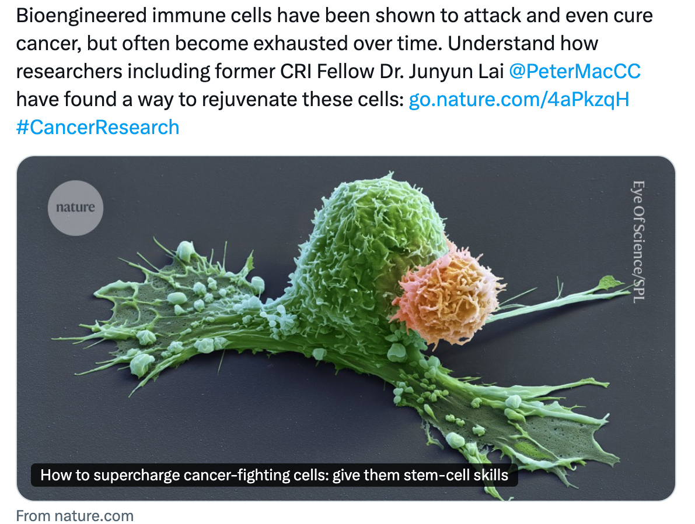
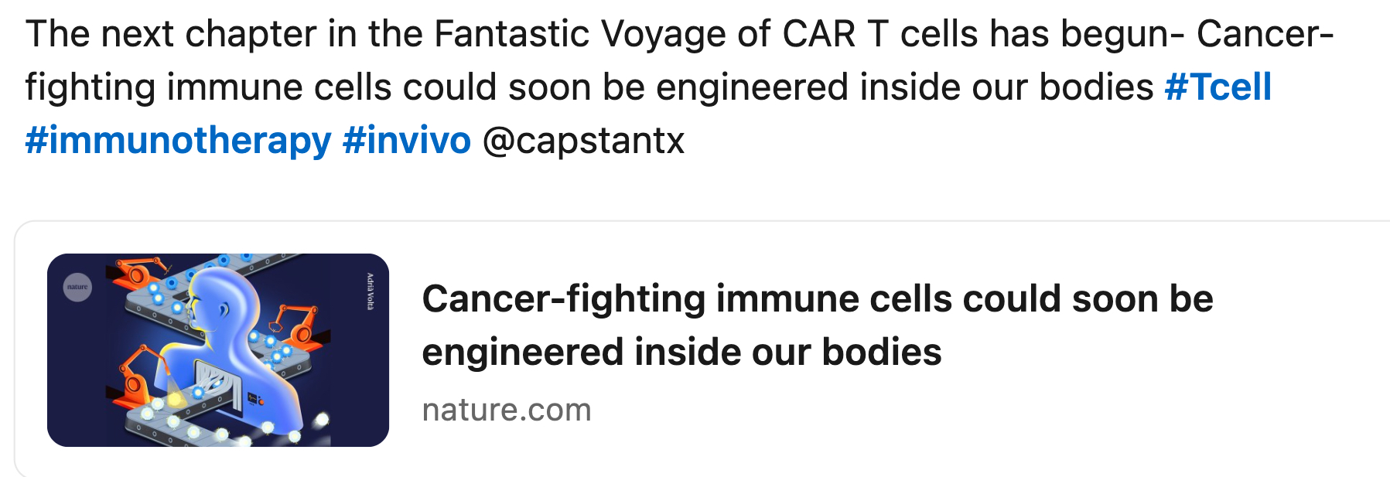
A FEW EXAMPLES
02
01
03
X
Instagram
Memorable?
What worked?
What didn’t work?
LinkedIn

Slide 6

a “hook” to grab attention
plain language
visually appealing (e.g., images, graphs)
short captions
- why the research matters (impact)
- engagement techniques (e.g., hashtags)

Slide 7

PRINCIPLES
02
Principles of Effective
Science Communication

Slide 8
The 3 Cs
01
03
02
CLARITY
CREDIBILITY
CREATIVITY
(1) Plain language,
(2) No jargon,
(3) Analogies
(but…)
(7) Accuracy,
(8) Referencing,
(9) Transparency
(4) Visuals,
(5) Storytelling, (6) Humour (but…)

Slide 9

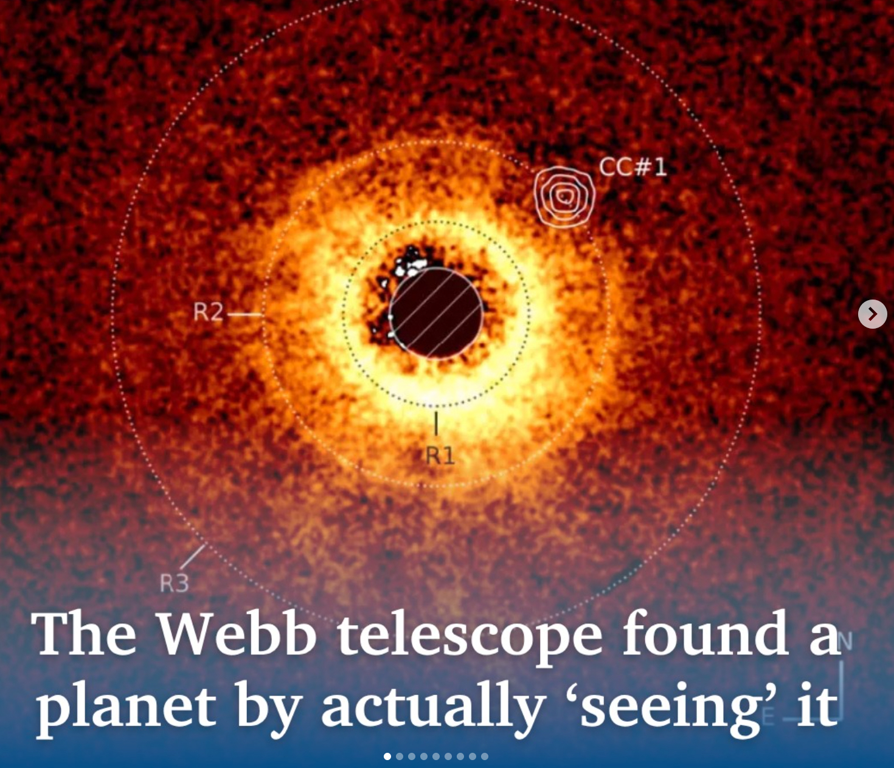
IN DEPTH: CLARITY
PLAIN LANGUAGE
AVOID JARGON
USE ANALOGY
Instagram
clear and accessible, short, simple sentences, active voice
define technical terms, simpler alternatives, concrete examples
powerful tools [the known and the unknown], deeper conceptual understanding, audience engagement (but…)

Slide 10
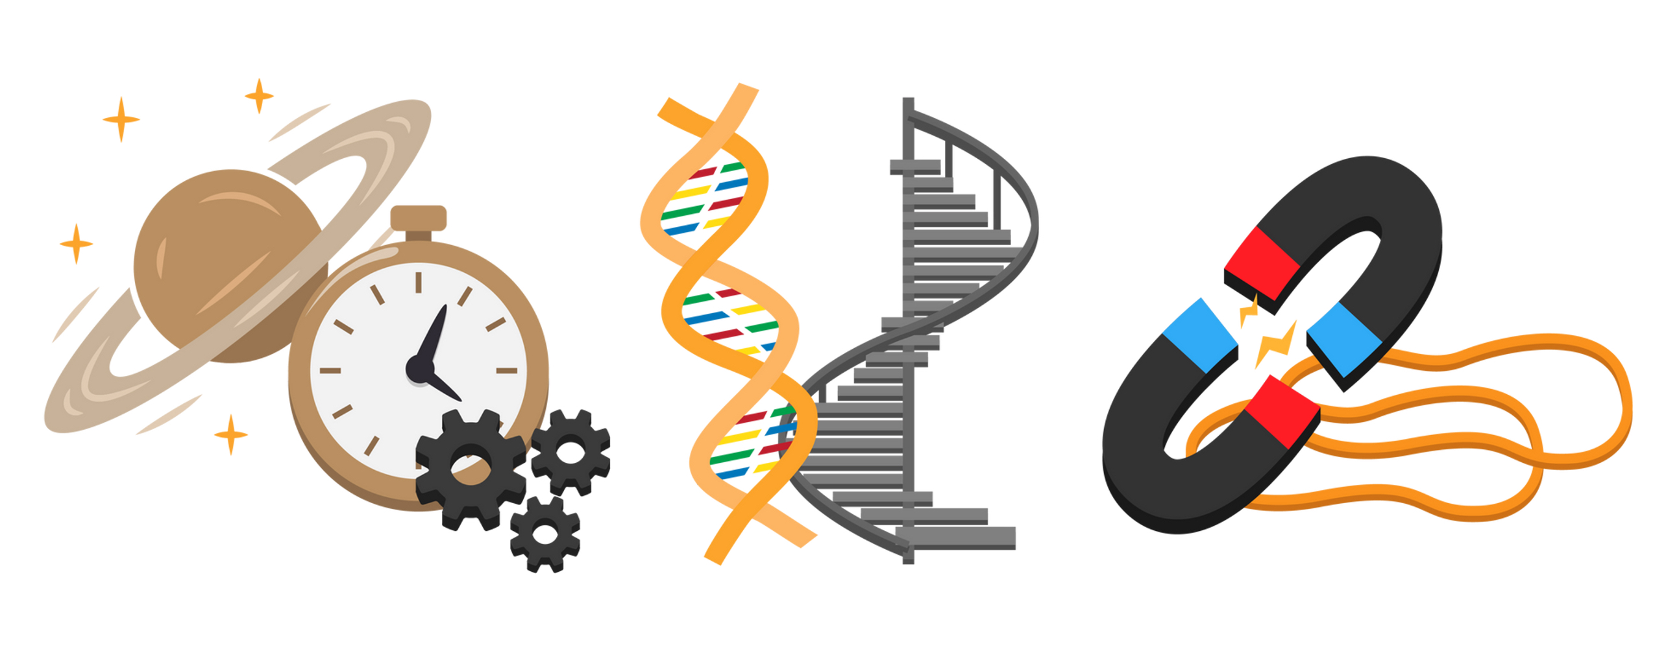
Twisted Ladder (Watson and Crick)
Clockwork Universe (Newton)
Rubber Band (Feynman)

Slide 11
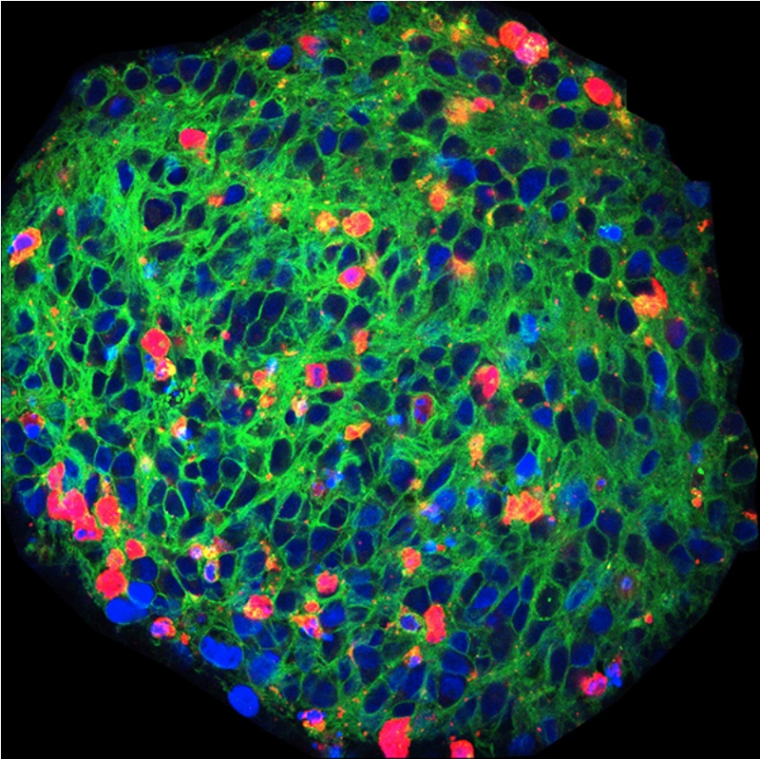
IN DEPTH: CREATIVITY
VISUALS
STORY TELLING
HUMOUR
reinforce concepts, large amounts of data optically
Stories as a wrap-up device for science
audience engagement (but…)
Advanced Science: https://advanced.onlinelibrary.wiley.com/doi/full/10.1002/advs.202101437

Slide 12
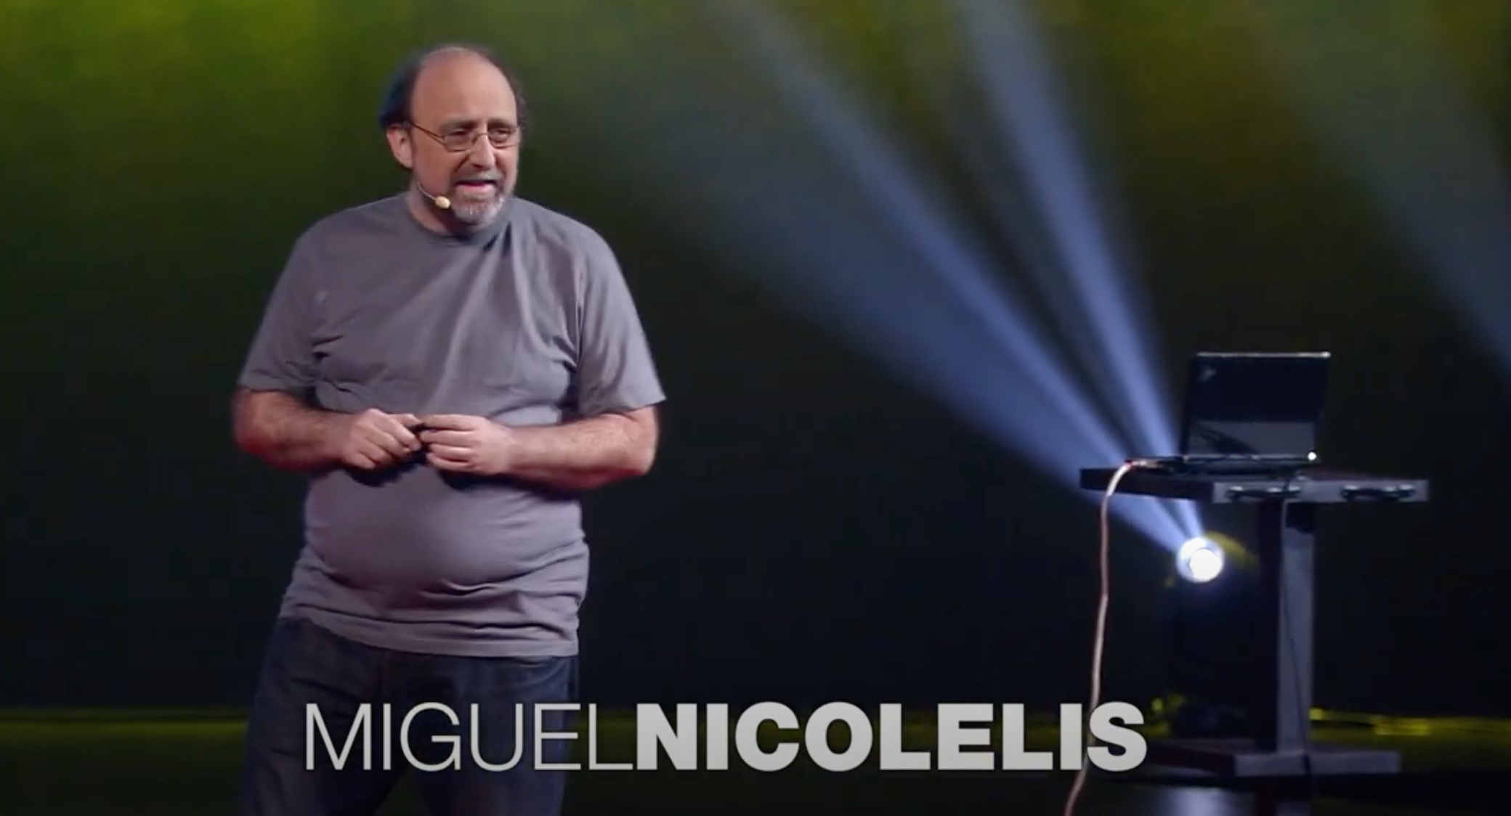
Story-telling in Science Communication
Miguel Nicolelis: Brain-to-brain communication has arrived. How we did it
https://www.youtube.com/watch?v=HQzXqjT0w3k

Slide 13
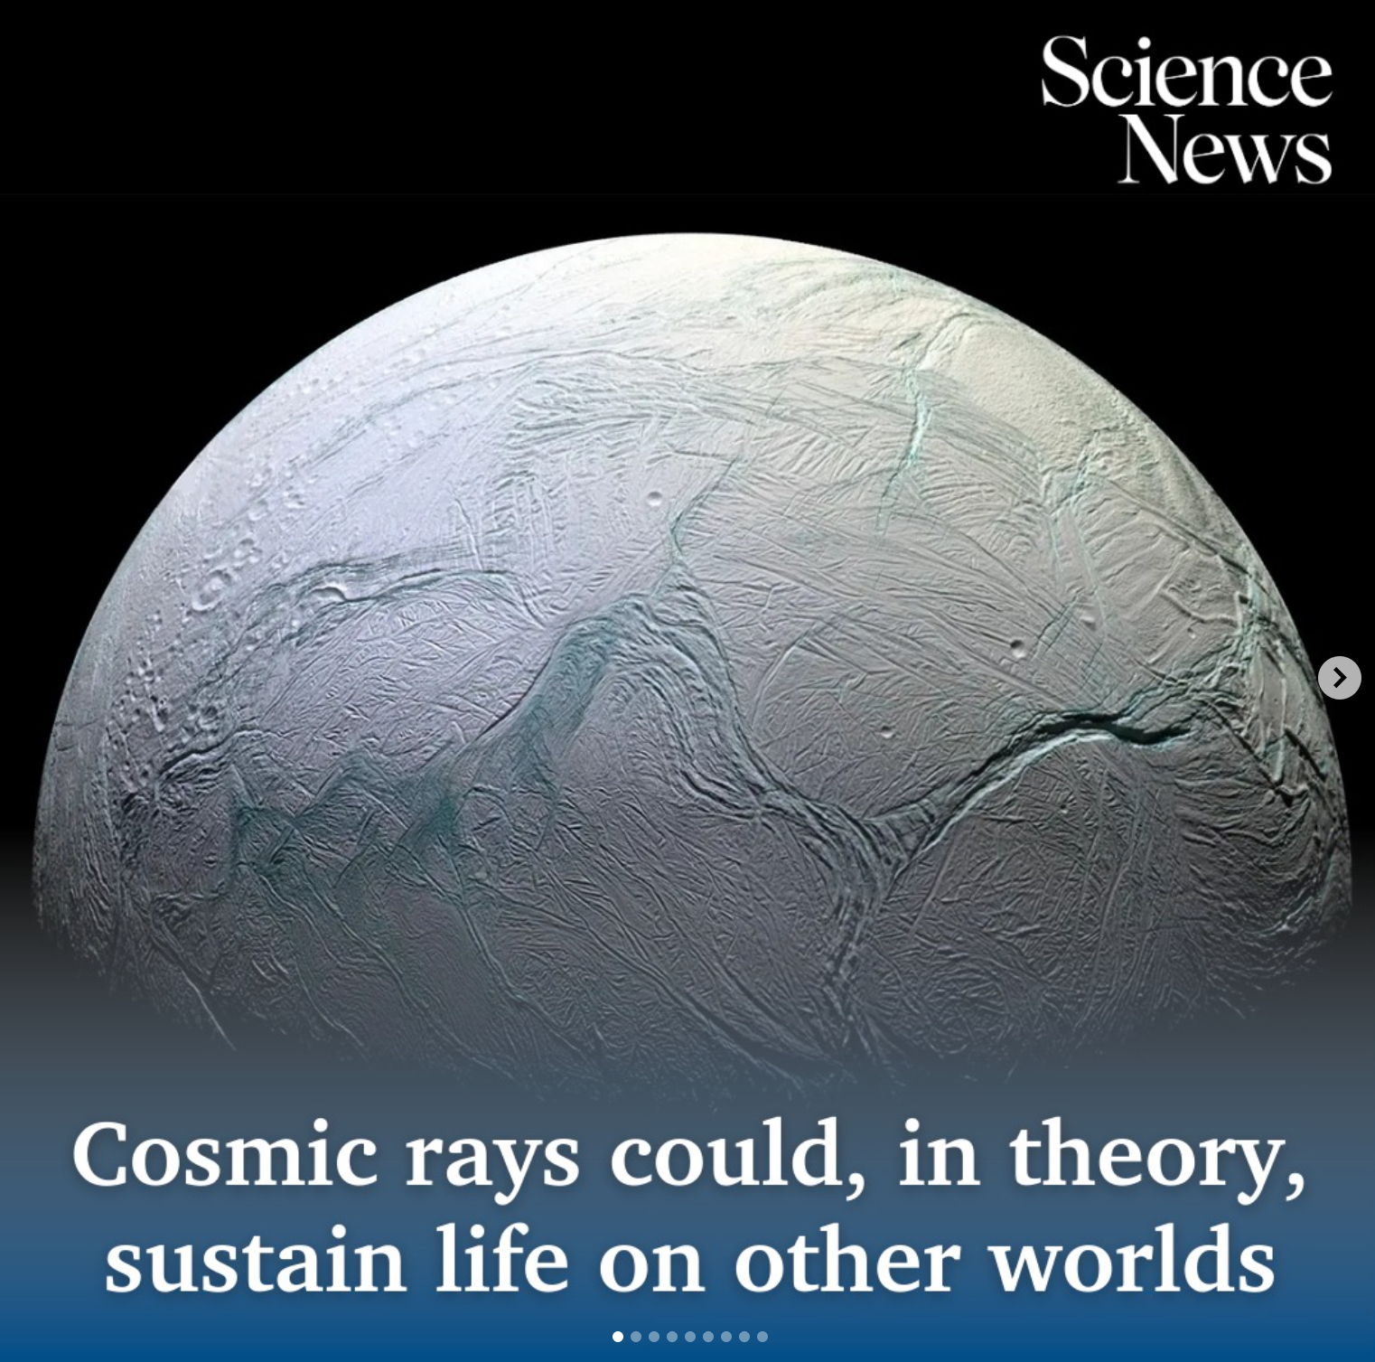
IN DEPTH: CREDIBILITY
ACCURACY
REFERENCING
TRANSPARENCY
report truthfully and objectively, avoid distortions (translation)
double-check accuracy of references… AI hallucinations
be honest and transparent, avoid overclaiming

Slide 14
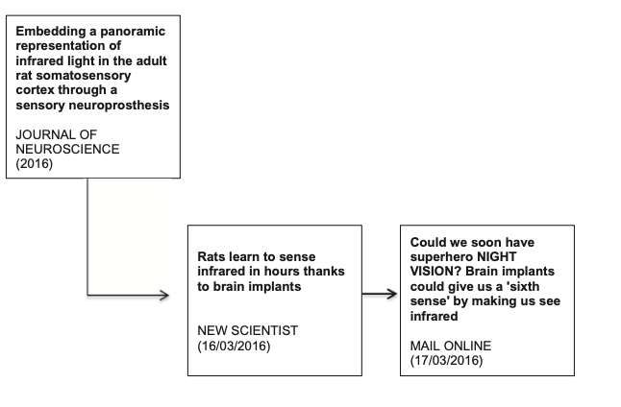
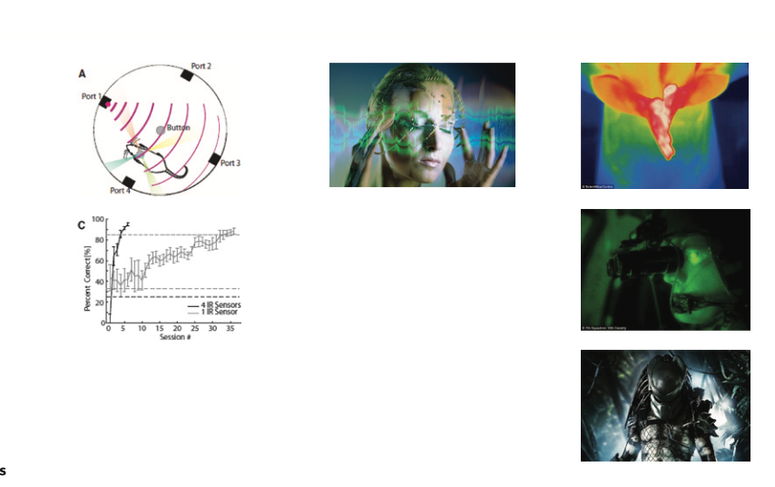
Lost in Translation
1
2
3
2
1
Gimenez, et al. (2020).Reproduced, reinterpreted, lost:
Trajectories of scientific knowledge across contexts.
Text & Talk, https://doi.org/10.1515/text-2020-2059
3

Slide 15
How credibility is lost…
Comments on a recently rejected manuscript:
“We are working especially hard these days to identify citation and AI-generated issues at the desk-review stage.” Journal editor
“While the manuscript raises important questions and some claims may be
valid, the use of unrelated citations risks undermining its credibility
and spreading misinformation.” (emphasis added) Reviewer
“These inaccuracies [in referencing] make it very difficult to accept the claims that the Authors are making in key sections of the manuscript such as the introduction and the literature review, especially in the latter which is supposed to have informed the conceptual framework of the study.” (emphasis added) Reviewer

Slide 16
plain language
story telling
analogies and humour (but…)
- lost-in-translation effect
- accuracy and transparency
- check, check and check again

Slide 17

STRATEGIES
03
Key Strategies
for Different Platforms

Slide 18
Discussion
How do you go about planning a communication
piece for your research?
Do you have any preferred set of strategies?
How do you measure the impact of
your communication?

Slide 19

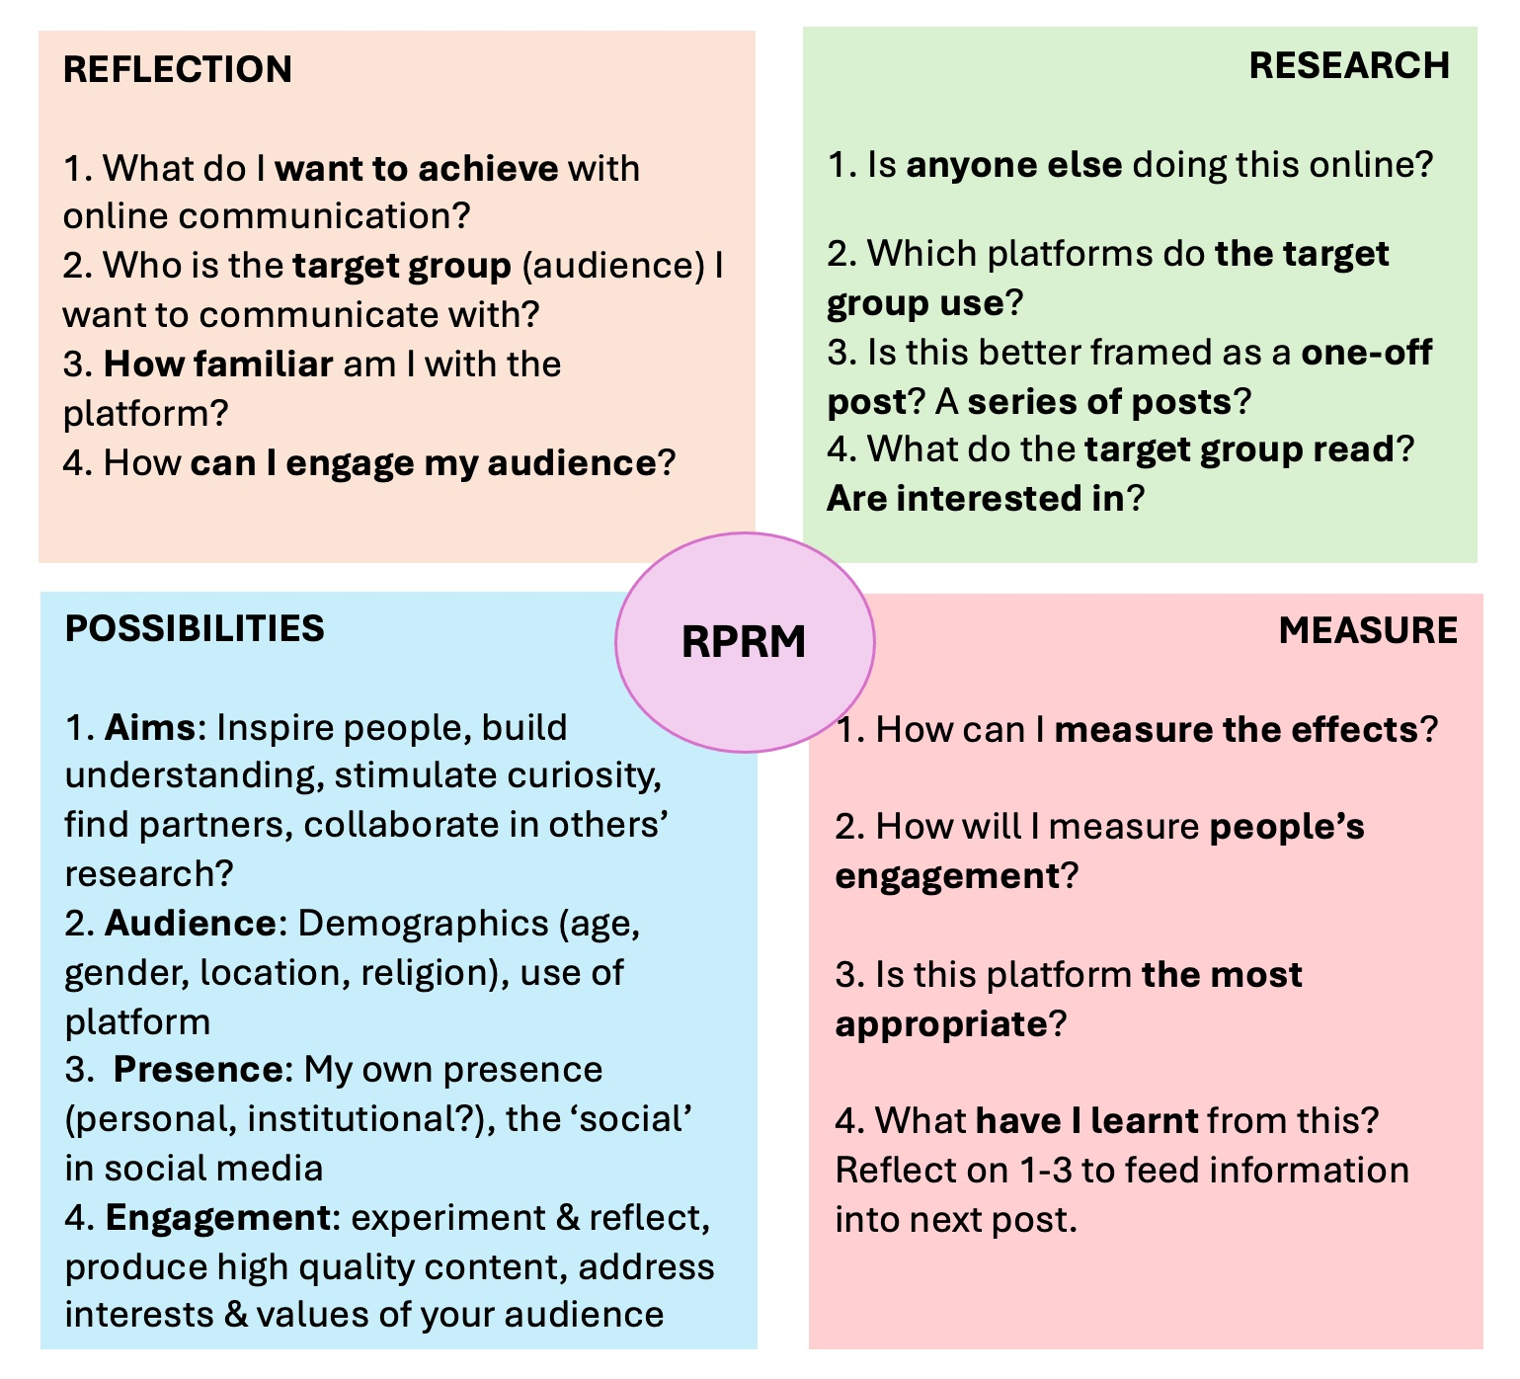
RPRM IN BRIEF
REFLECTION, POSSIBILITIES, RESEARCH, MEASURE

Slide 20

RPRM & KEY PLATFORMS

Slide 21
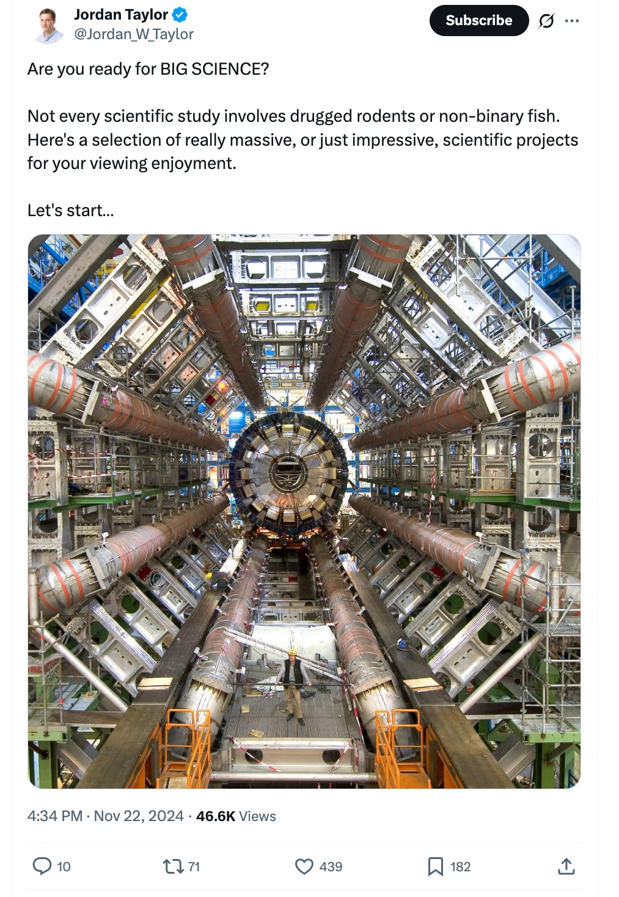
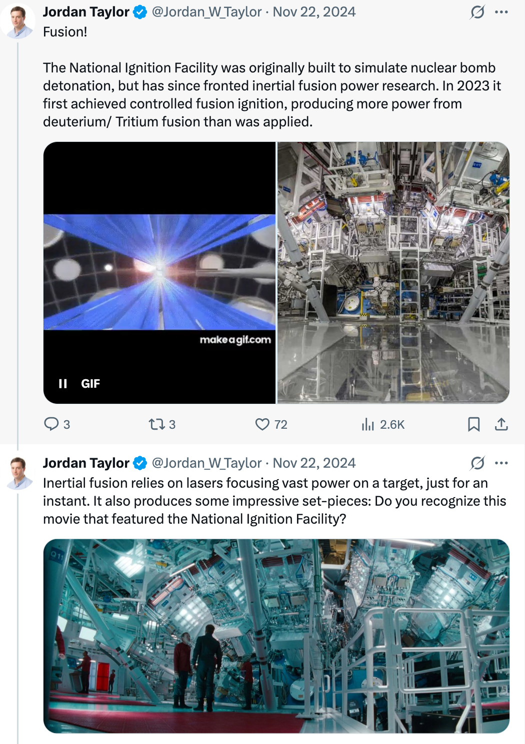
Twitter / X – Tweetorials- threads
1. RPRM Strategy?
2. How was the Tweetorial/thread created?
3. Why it worked (or didn’t)?
Posts can be
AI enhanced!

Slide 22
Instagram – Visual Storytelling
https://www.instagram.com/p/DNif9QkI81s/

Slide 23

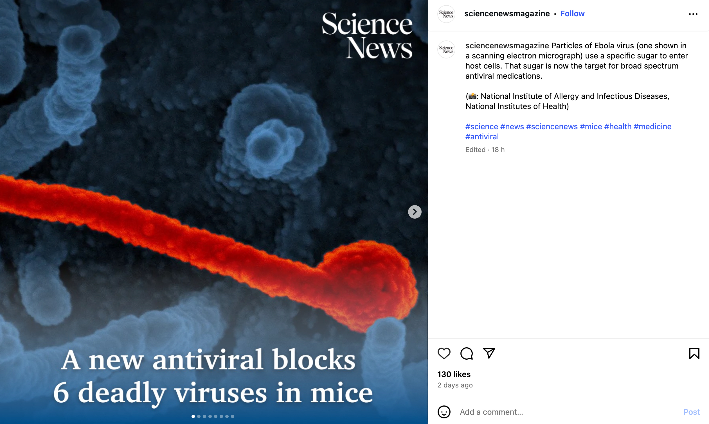

Instagram – Visual Storytelling
1. RPRM Strategy?
2. How was the story told?
3. Why it worked (or didn’t)?
Posts can be
AI enhanced!

Slide 24
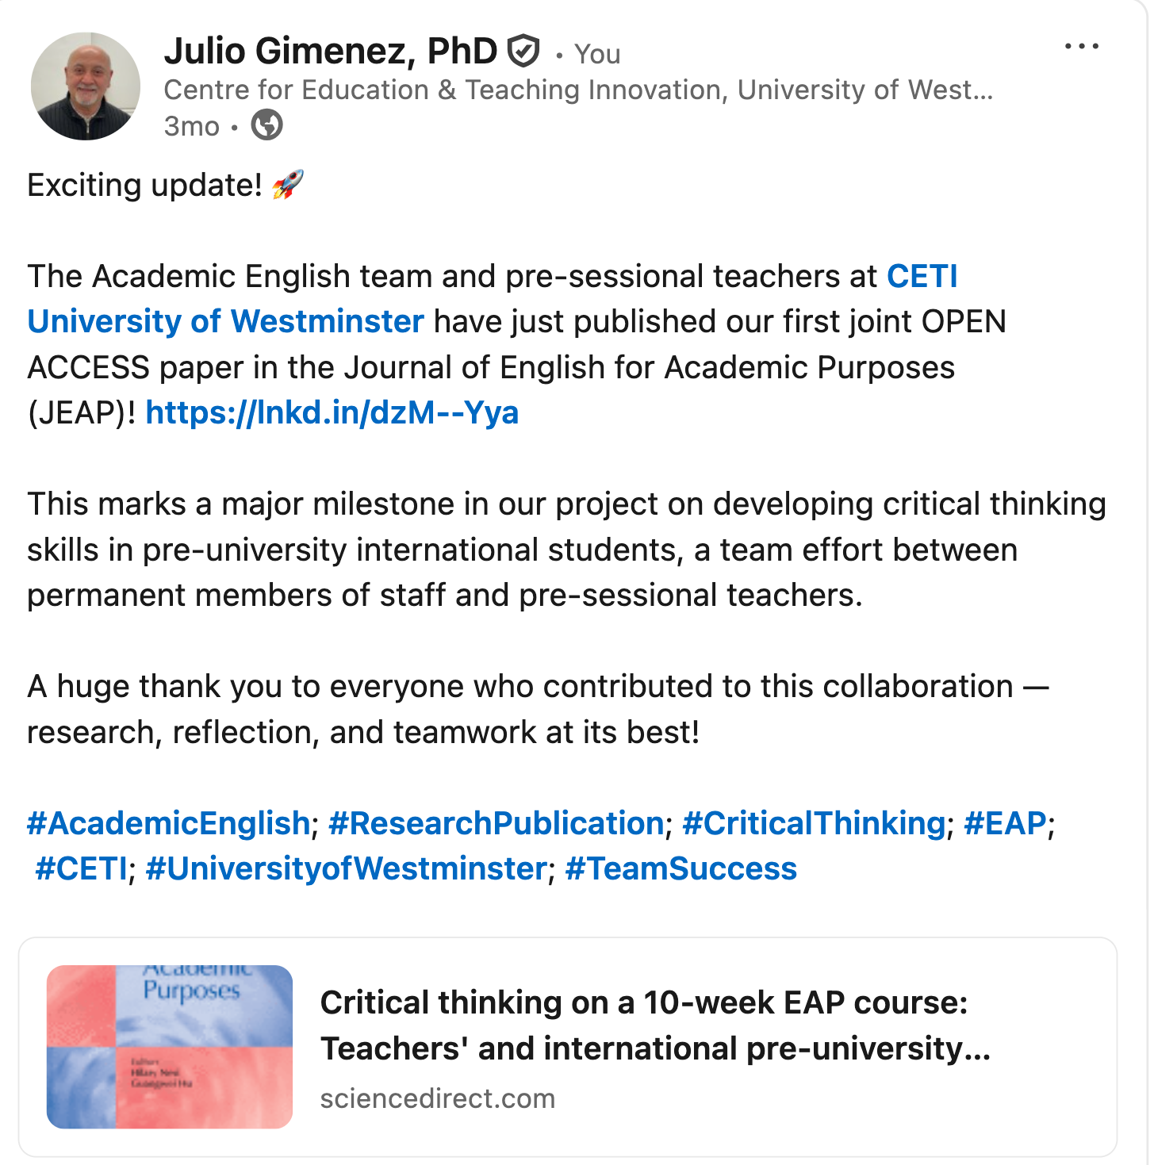
LinkedIn – Professional Narratives
Apologies for the plug!
1. RPRM Strategy?
2. Why was the narrative created?
3. Why it worked (or didn’t)?
NOTE: AI enhanced!

Slide 25
To wrap up…

Slide 26
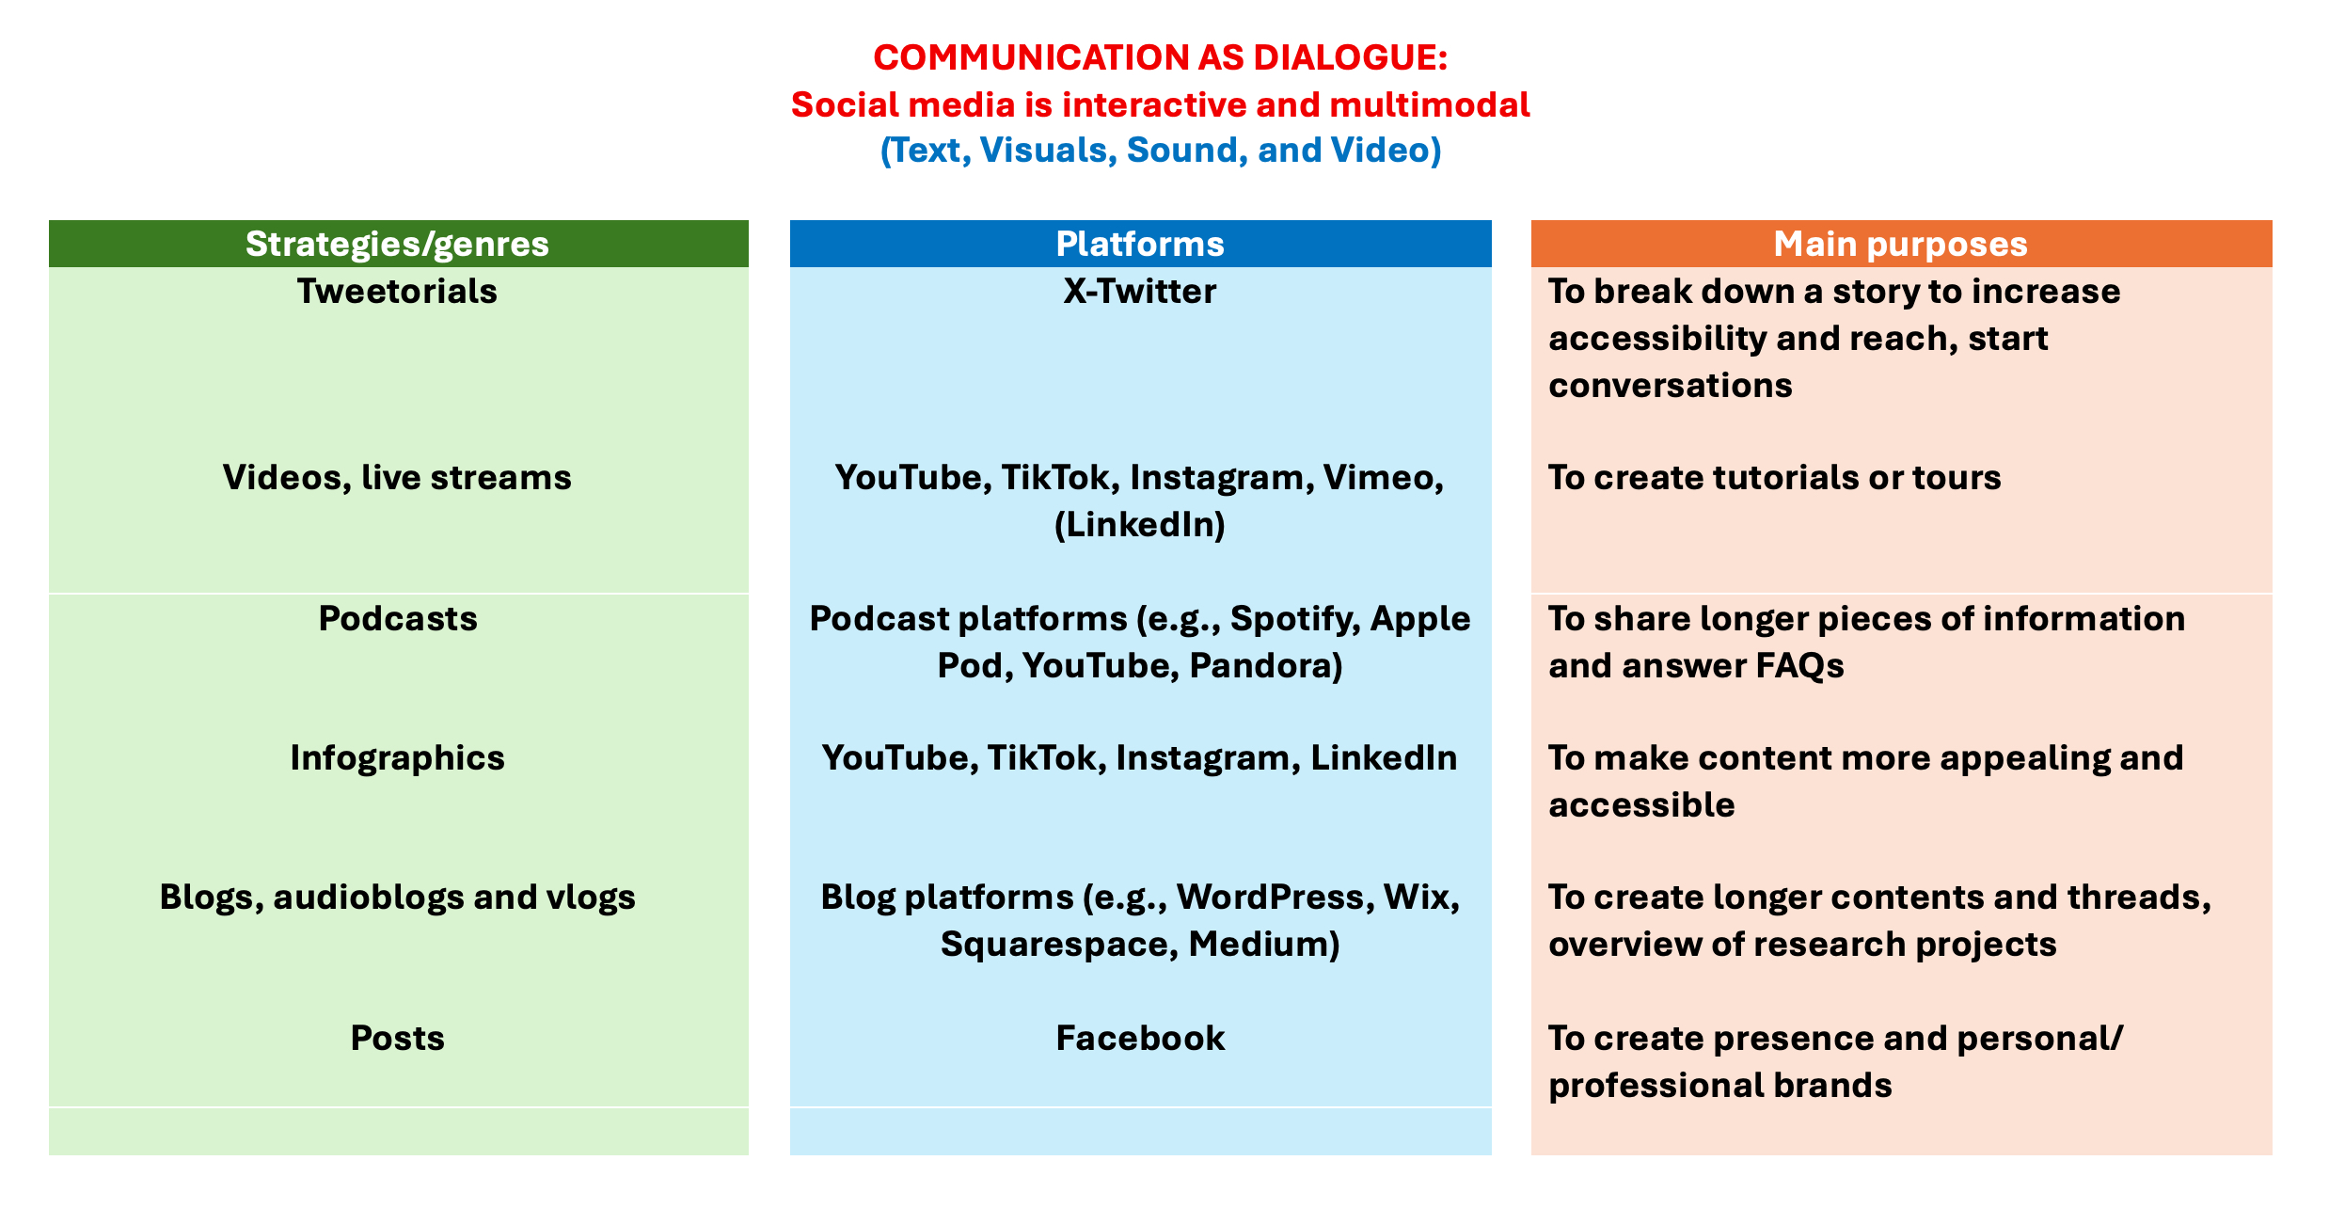

Slide 27
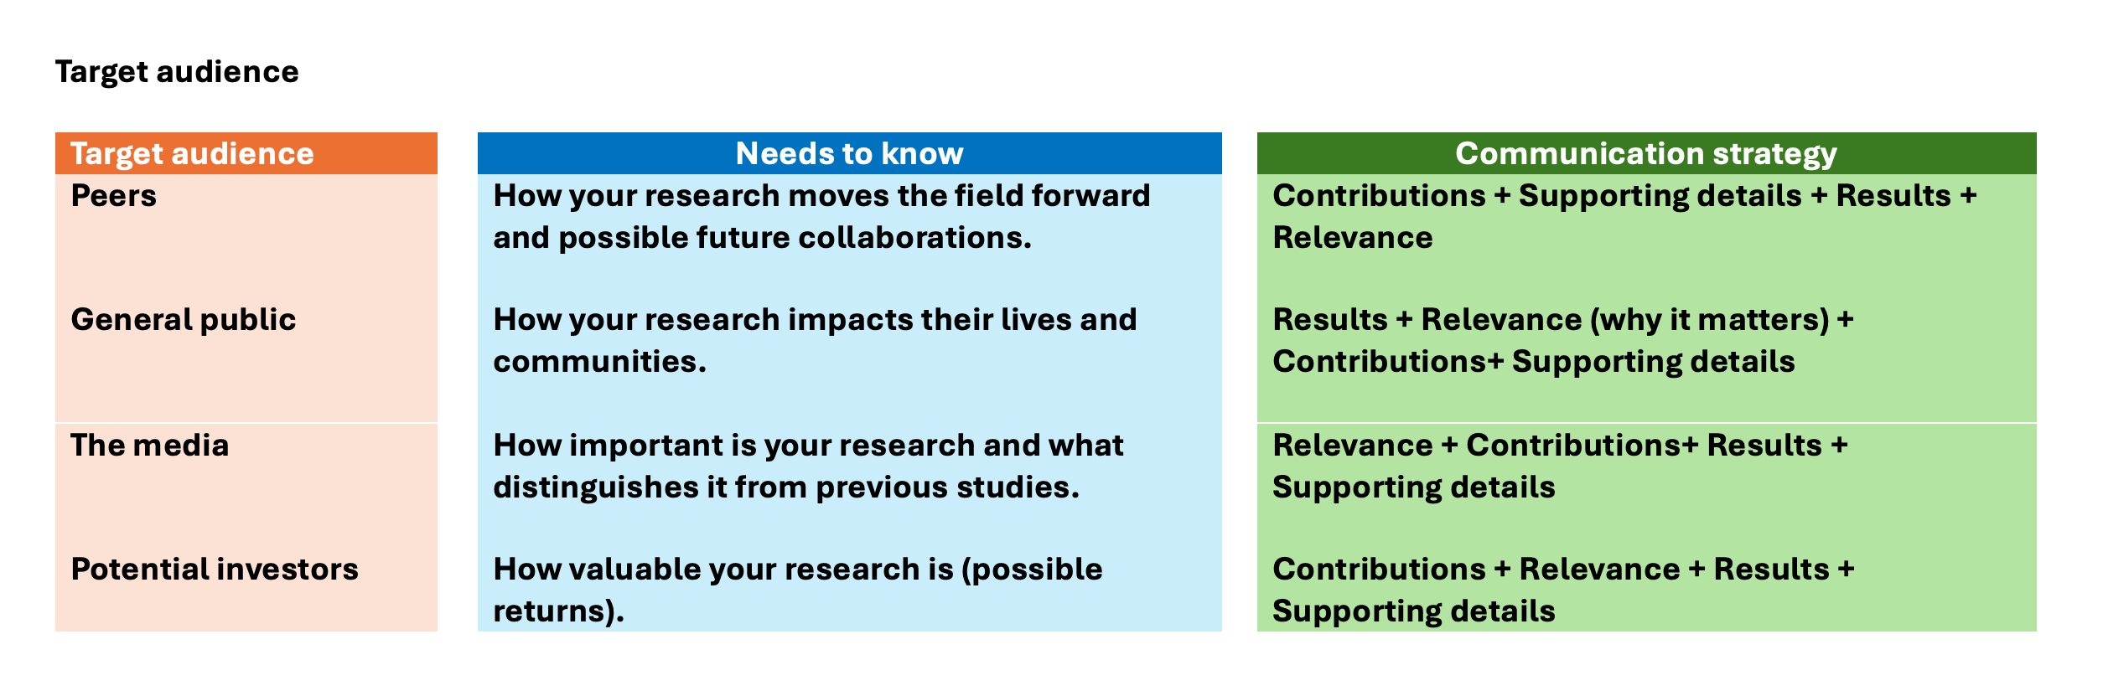

Slide 28
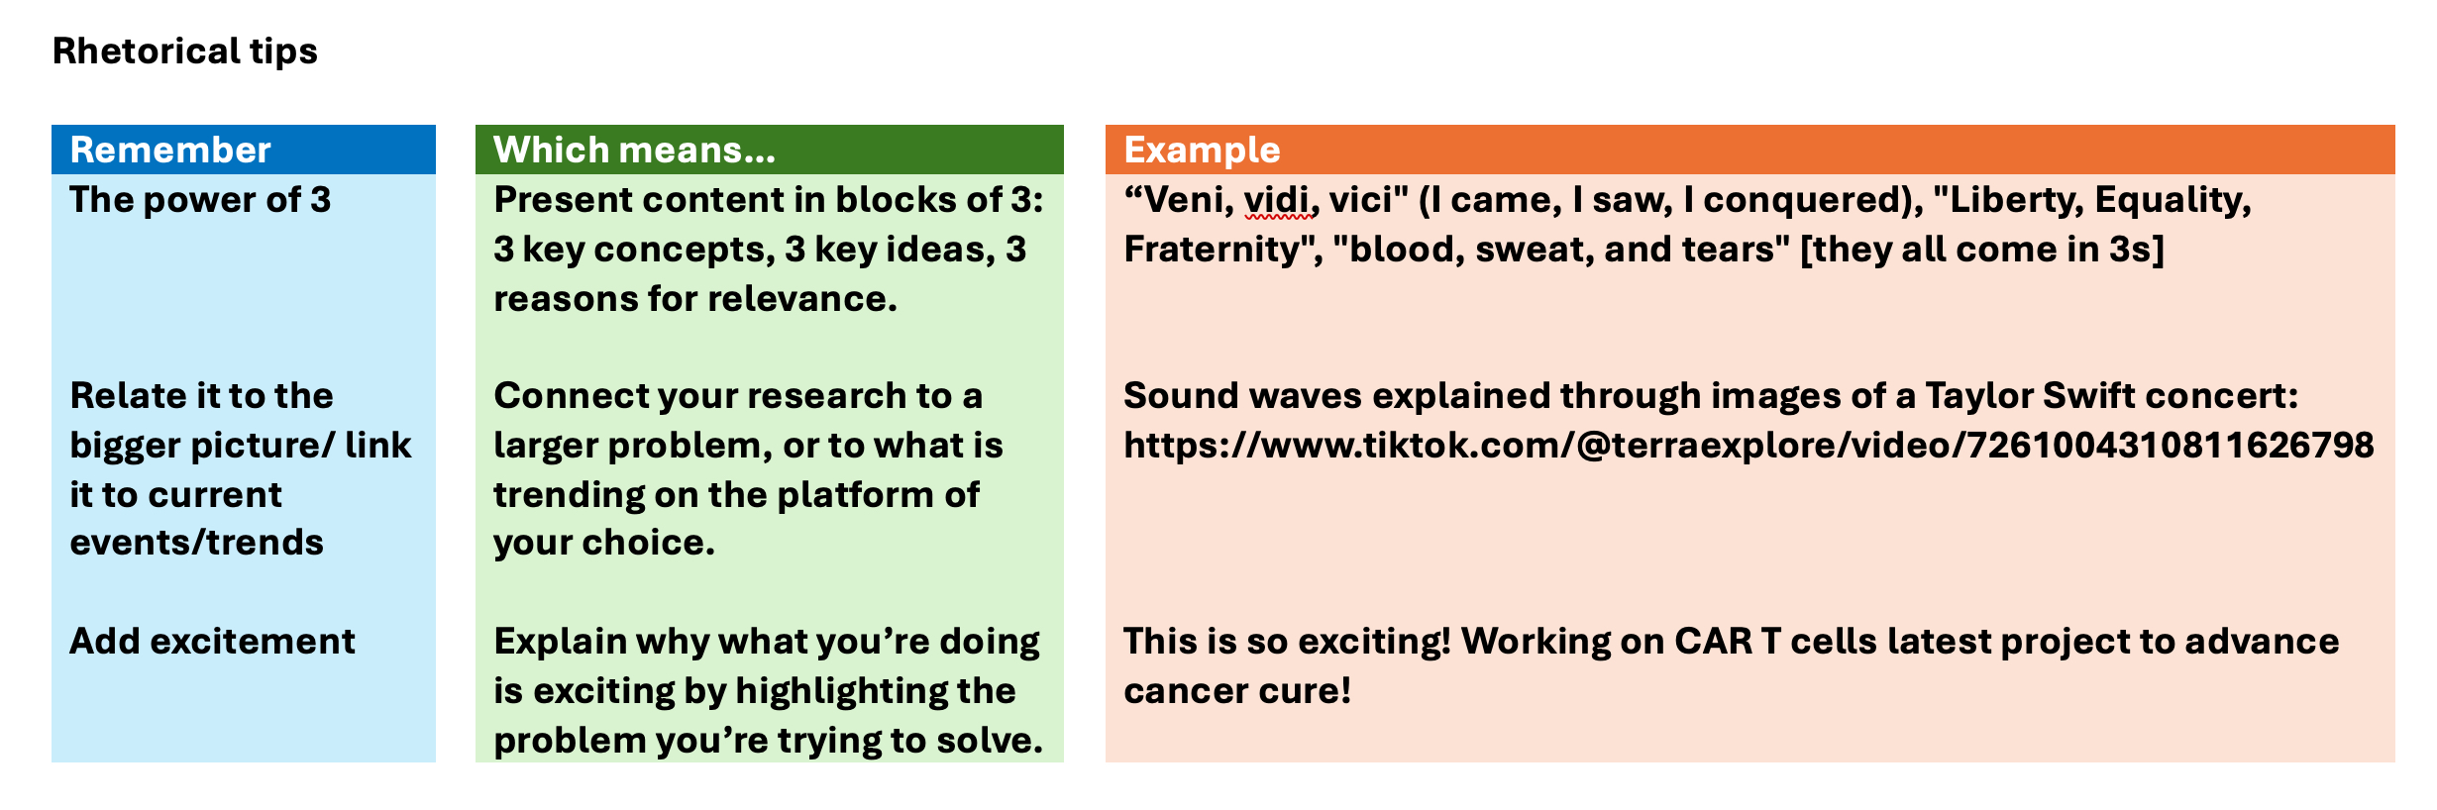

Slide 29

04
CRITICAL REFLECTION
Discussing and Sharing Ideas

Slide 30
Group Work
Discuss with your group: • What worked well on each platform? Think of the
principles and strategies we discussed.
• What challenges or risks do you see? Think of your
audience, presence and engagement.
• Which platform feels most natural for your research?
• How can AI enhance your communication strategy?

Slide 31

05
FINAL TASK
Drafting
Your Own Post

Slide 32
Your Research Post
Pick one platform and draft a complete post about your research. Think about: • Aims • Plain language • Tone and audience • Images, analogies, storytelling • Hashtags or links

Slide 33
SHARING

Slide 34
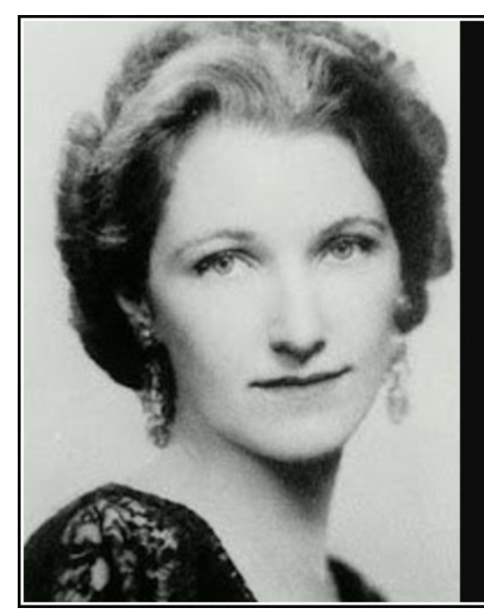
Nothing in science has any value to society if it is not communicated, and scientists are beginning to learn their social obligations.
Anne Roe Simpson (American clinical psychologist- 1904-1991)

Slide 35
From Research to Reach
Communicating Science Effectively on Social Media- Workshop
Julio Gimenez- University of Westminster

